Slide 1

Crise climatique & enjeux de la COP.21

Slide 2

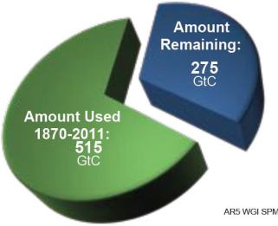
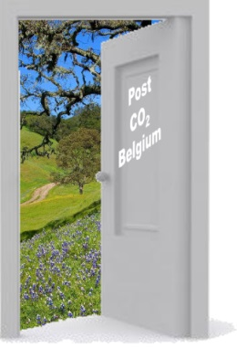

Long term goal: 2°C
Carbon budget & emissions gap
Transition towards low-carbon economy
COP.21: headlines and key challenges
Post CO2

Slide 3
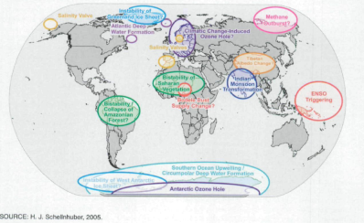
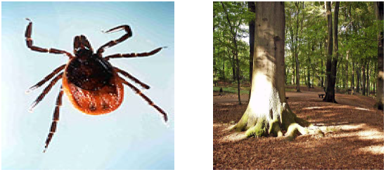
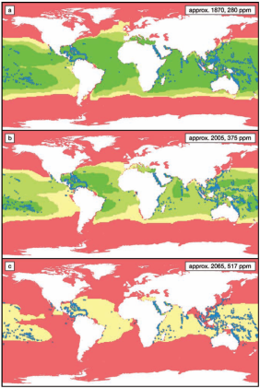
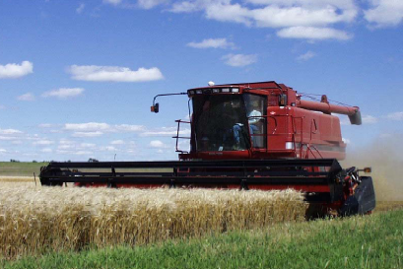
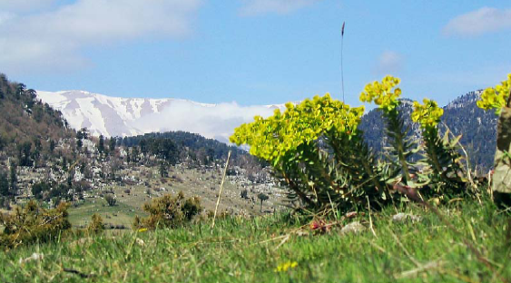
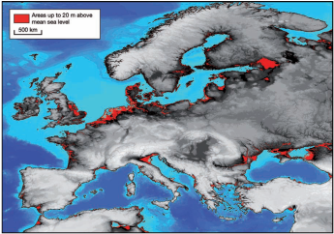
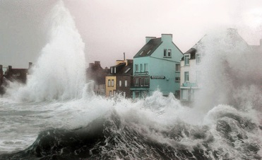
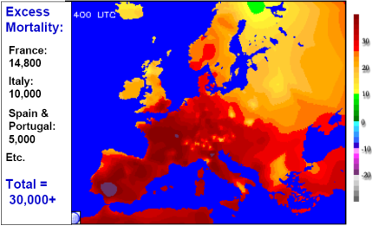
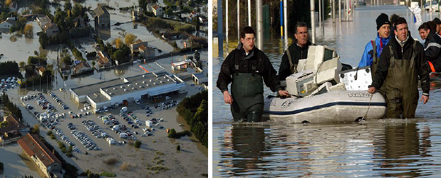

Impacts of CC

Slide 4
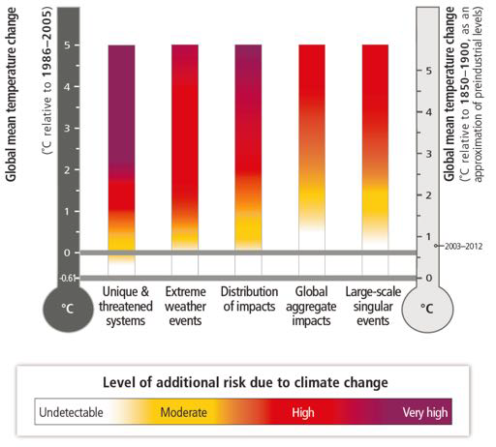
Risk assessment → 2 degree target
Long term objective: max. +2°C
Today: +0,8°C
Source: IPCC AR5

Slide 5
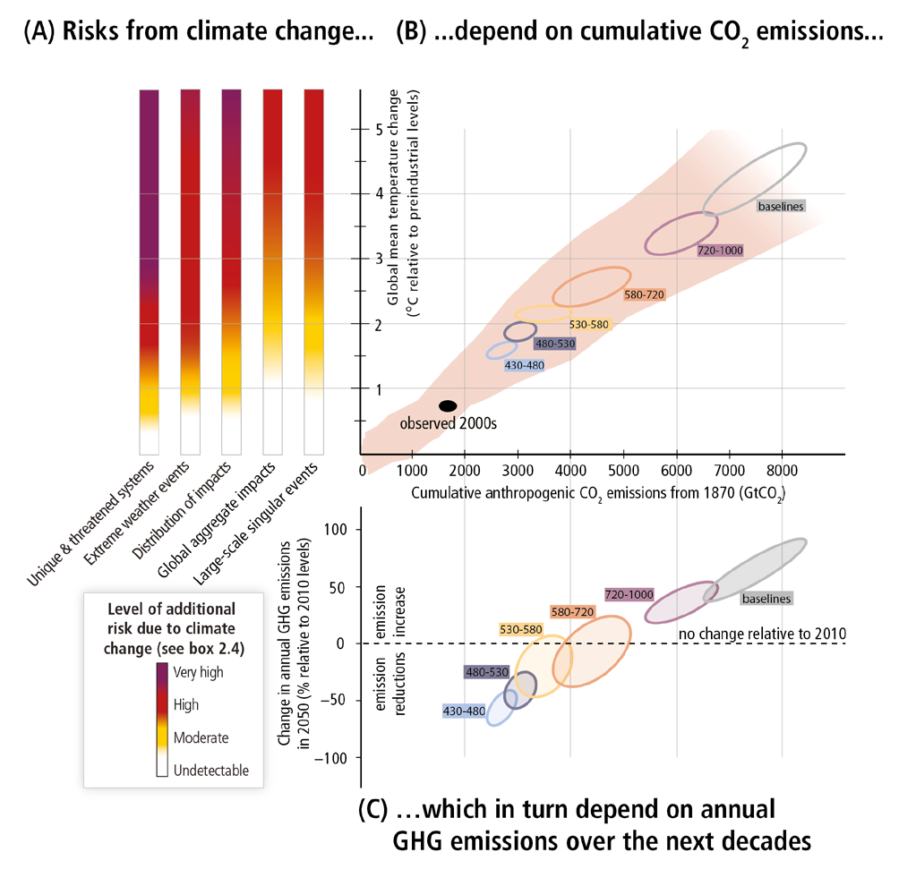
From risks to carbon budget and emissions

Slide 6
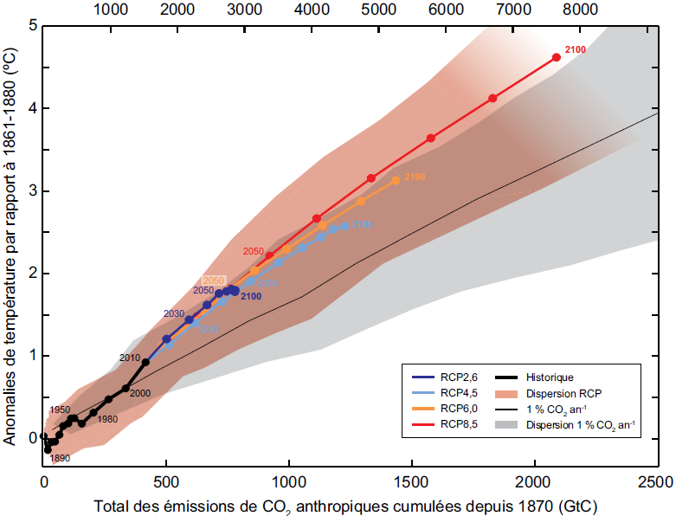
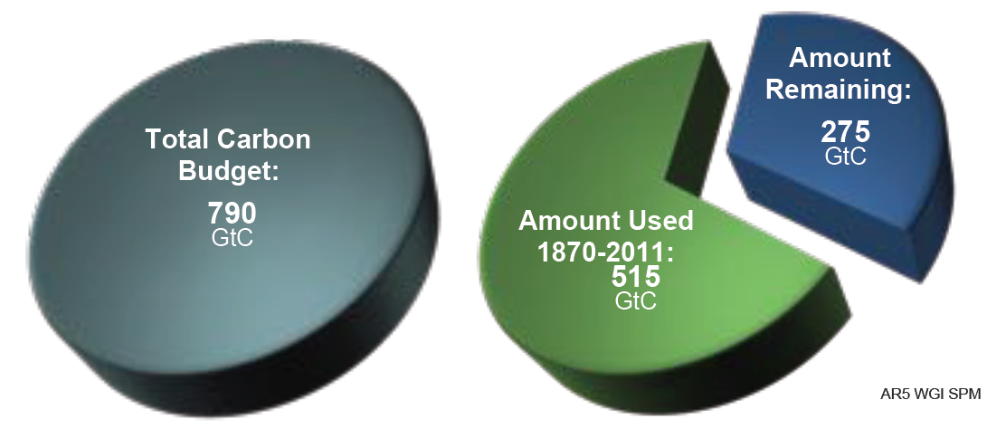
Carbon budget compatible with 2°C (probability > 66%):
Max. cumulated GHG emissions = 790 GtC
Already emitted today: 550 GtC (> 2/3 of the total C budget)
C budget available for the future = 240 GtC (=25 yrs of emissions at current rate)

Slide 7
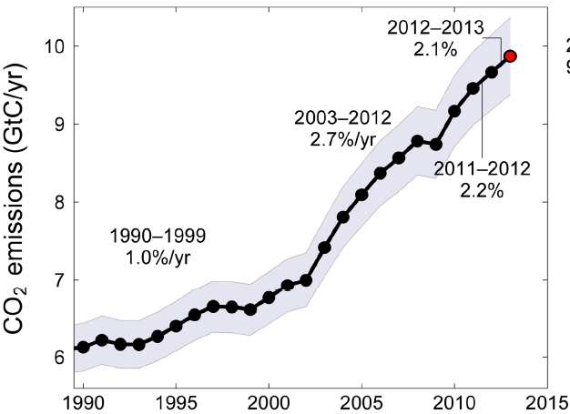
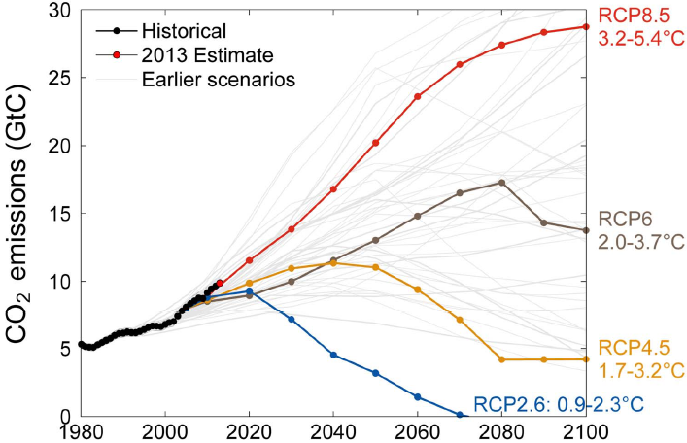
Current trends of global CO₂ emissions
Current trends of global CO₂ emissions is on a trajectory that drives us to +3,2 – 5,4°C by 2100 !
Source: Global Carbon Project (2013)

Slide 8
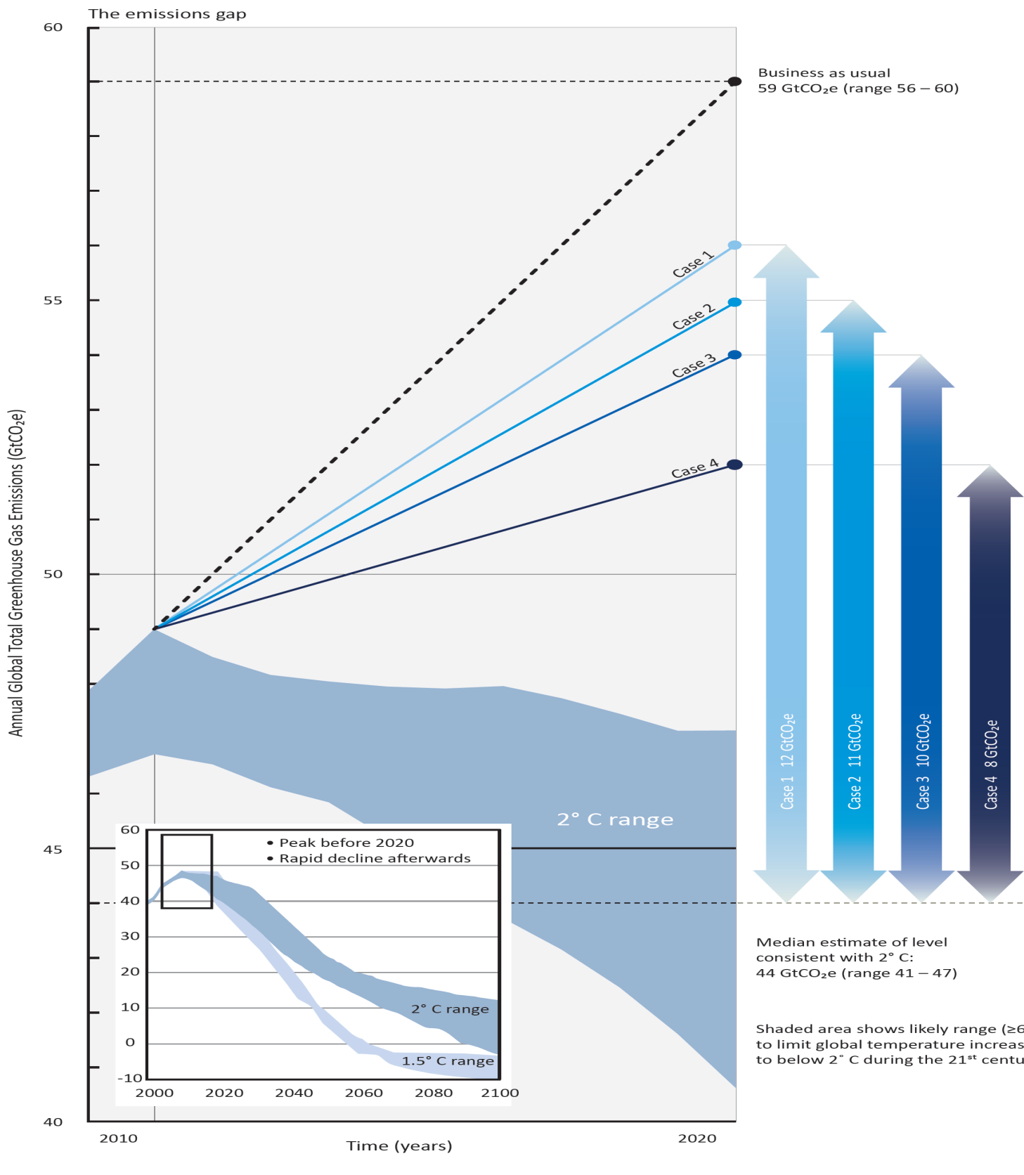
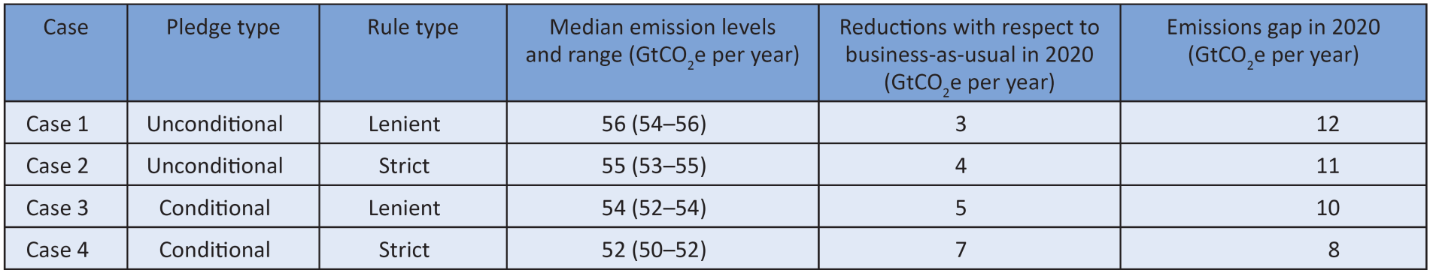
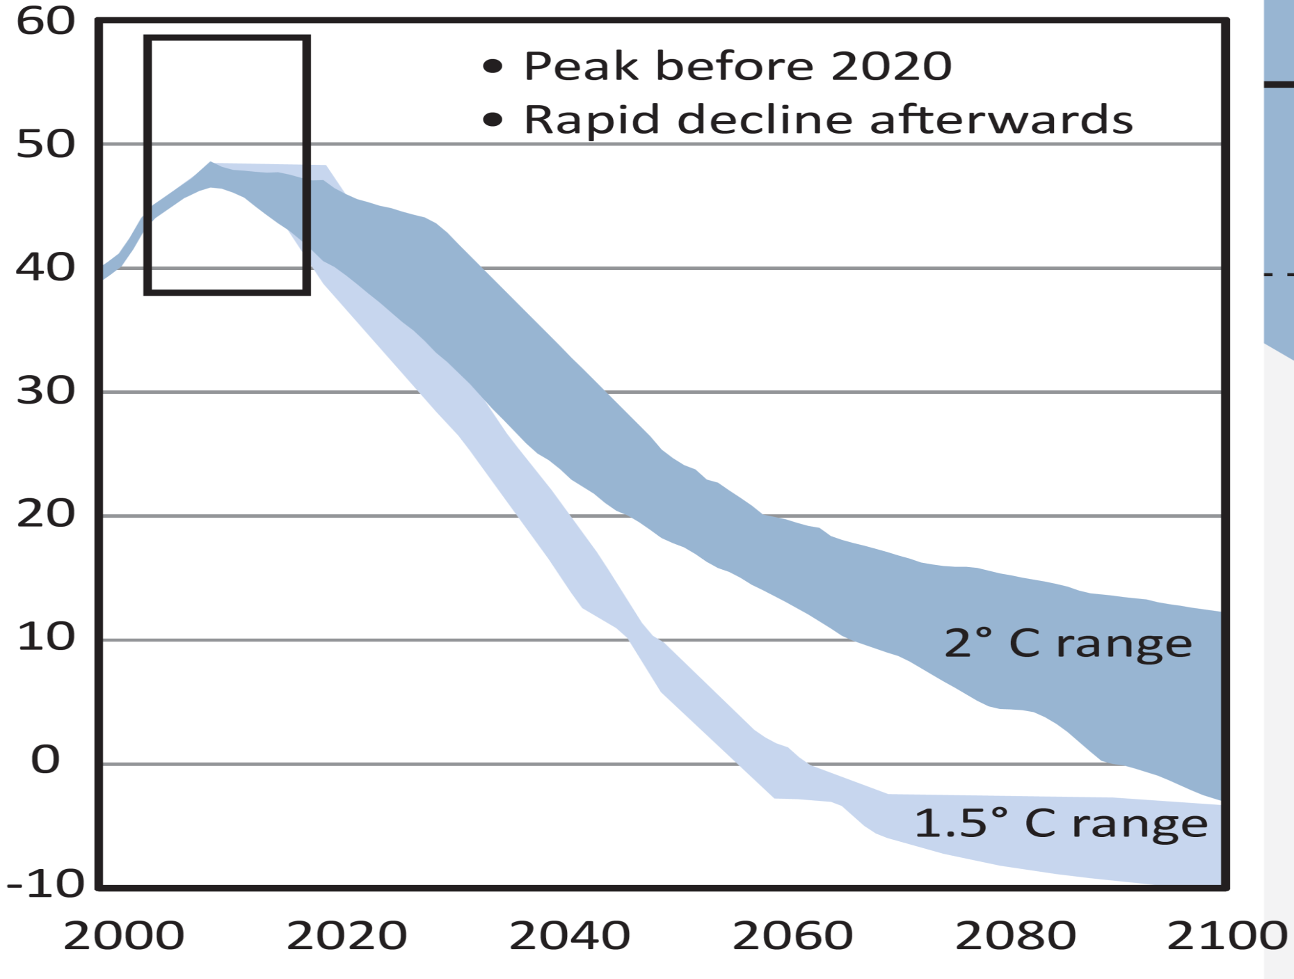
Source : UNEP gap report 2013

Slide 9
Transition
bas-carbone
Mutation du système énergétique mondial (recours systématique aux technologies bas-carbone, efficacité énergétique dans tous les secteurs, électrification, mutation des systèmes de transport)
Modes de production et de consommation durable (sobriété dans l’utilisation des ressources non-renouvelables)
Utilisation durable du sol (agroécologie, arrêt de la déforestation) et urbanisation durable

Slide 10
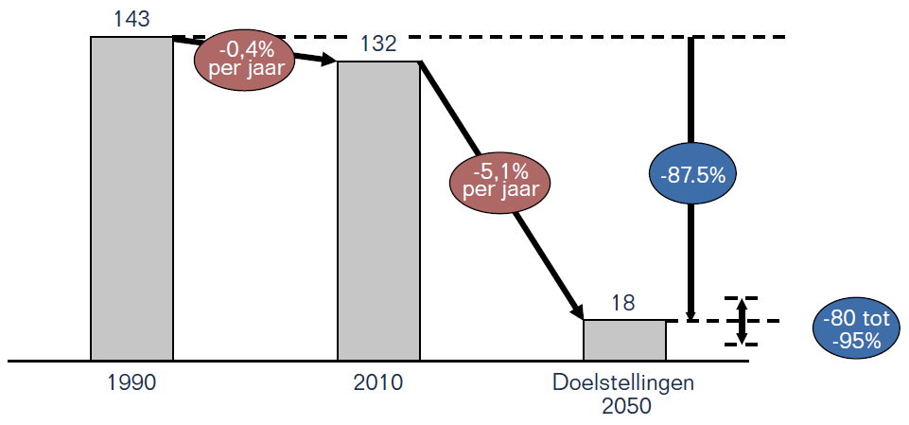
Low carbon transition in Belgium
Historische evolutie van de uitstoot van broeikasgassen in België (MtCO₂eq./jaar) en de range van de 2050-doelstellingen.
(Studie “Scenario’s voor een koolstofarm België tegen 2050”, FOD VVVL, Climact, Vito, 2013)

Slide 11
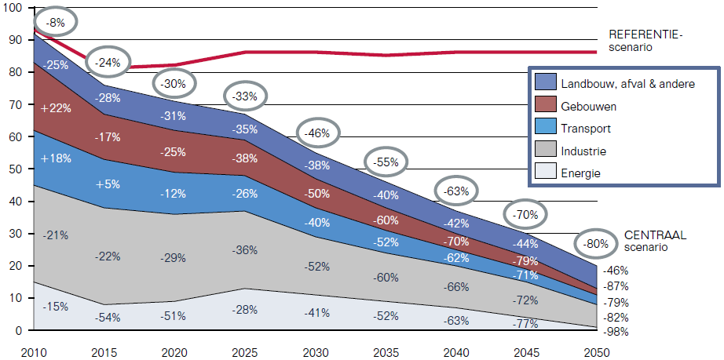
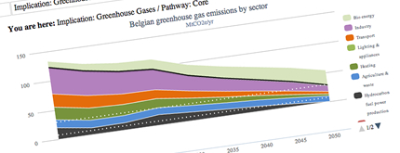
Low C transition in Belgium
Evolutie van de Belgische uitstoot van broeikasgassen per sector en in totaal t.o.v. 1990 (in %) in het CENTRAAL scenario (index: 1990 = 100)
(Studie “Scenario’s voor een koolstofarm België tegen 2050”, FOD VVVL, Climact, Vito, 2013)
Creëer je eigen koolstofarme scenario
op www.klimaat.be/2050

Slide 12
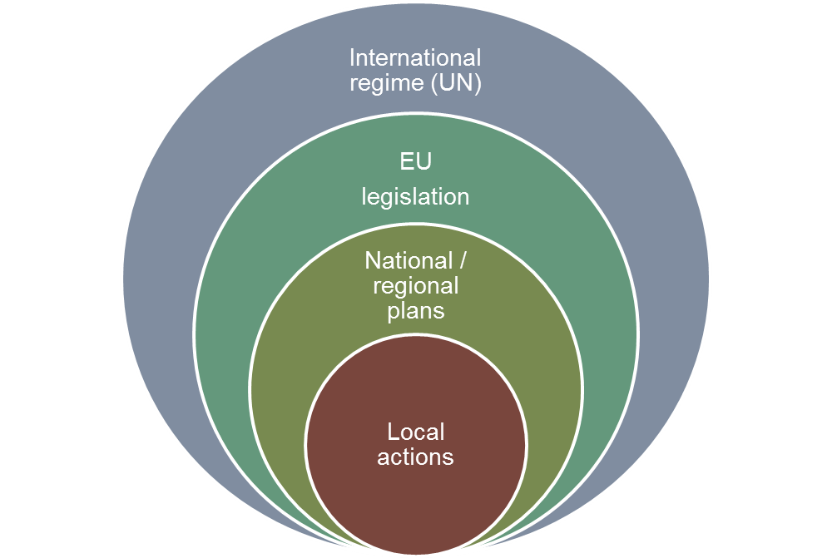
Multi-level action is required
Key challenges:
Mobilize human, technological, and financial means
Participation (citizens, business, gov. and non-gov. organisations,…)
Sense of urgency (window of opportunity)
Put in place a global climate governance framework
International cooperation

Slide 13







Climate negotiations: Historic perspective
1992
Klimaatverdrag
Kyoto Protocol
EU: -8% between 2008 and 2012 (~1990)
BE: -7,5%
1997
Copenhagen Accord & Cancún Agreements
EU: -20% (~1990) by 2020
100 billion USD per year by 2020
Green Climate Fund
2°C goal
2009/
2010
Durban Platform
Adopt a protocol, another legal instrument or
an agreed outcome with legal force under the Convention applicable to all Parties at COP21
2011
2012
Second Commitment Period KP
EU: -20% (~1990) between 2013 and 2020
2015
2015 Agreement

Slide 14






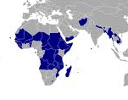



















Major negotiating groups
Annex 1 (“NOORD”)
Non-Annex 1 (“ZUID”)
EU 28+
G77+China
EIG
LDCs (48)
African
Group (53)
AOSIS (39)
AILAC
BASIC
Umbrella Group
LMDC
ALBA
Arab
Group

Slide 15

Objectives
Mitigation
Research and Systematic Observation
Building Blocks of the climate regime
Education, training and public awareness
Principles
Adaptation
Finance
Institutions
Reporting, Accounting, Compliance
Support
Techno-logy
Capacity
Building

Slide 16
Key elements to be discussed at COP.21
New treaty (long term agreement)
Commitments
Finance
Lima-Paris Action Agenda
Long term global goal (2°C → decarbonisation by the end of the century)
Ambitious Intended Nationally Determined Contributions (INDCs)
Ambitious pledges (pre 2020 and long term)
Public & private innovative sources
Redirect private investments towards low carbon activities
Enhanced cooperation of state and non-state actors (cities and regions, business, public/private investors, international institutions,…)
Mitigation and adaptation at the core !
Periodic review
"a protocol, another legal instrument or agreed outcome with legal force"

Slide 17
Key challenges (1) : mitigation
Ambition
Adequacy of commitments with long term global goal
Periodic Ambition cycles
Differentiation
Creative reading of the principles of the Convention (equity, CBDR/RC, specific needs et special circumstances of DCs)
Move away from the firewall (developed vs. developing world)
Rules & Transparency
Common rules to evaluate commitment & global ambition
Should apply to all Parties, while with differentiation
Markets
New market mechanisms to be created
Robust common accounting rules = prerequisite to avoid hot air

Slide 18
Key challenges (2) : finance
120
100 GUSD
100
80
Long Term Finance:
scaled-up,
new and additional,
predictable
adequate
wide variety of sources
public and private
bilateral and multilateral
alternative sources
GCF: significant share of adaptation funding
60
Fast Start Finance:
new and additional resources
balanced adaptation/mitigation
priority to LDCs, SIDS and Africa
annual reporting + compilation
40
20
30 GUSD
0
2010
2011
2012
2013
2014
2015
2016
2017
2018
2019
2020

Slide 19

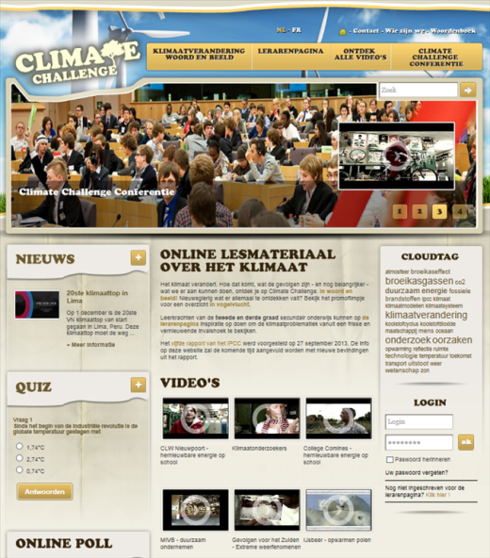

Sensibilisation et éducation: activités du Service fédéral Changements climatiques (SPF – DG Environnement)
Diffusion de l’information vers les écoles
1aire & 2aire Secondaire Ecoles supérieures
(10 - 14 ans) (15 – 18 ans) (> 18 ans)
dossier éducatif www.climatechallenge.be sessions de formation pour les futurs enseignants
6000 fardes
+ conférences de négociation
à l’école/au parlement européen

Slide 20
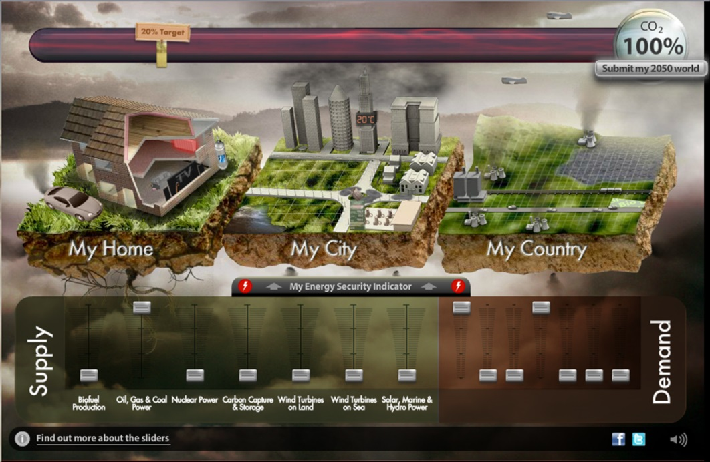

Sensibilisation et éducation: activités du Service fédéral Changements climatiques (SPF – DG Environnement)
En construction: “My 2050 BE”
Site éducatif interactif
(partenariat avec Climact, Potsdam Institute et le WWF)
Cibles:
  écoles (3ème degré du 2^{aire})
  grand public
Objectifs:
  sensibiliser aux défis de la transition bas-carbone
  faire réfléchir sur les leviers et les ambitions (plusieurs scénarios sont possibles)
Lancement: octobre 2015

Slide 21
“Ce n'est pas parce que les choses sont difficiles que nous n'osons pas, c'est parce que nous n'osons pas qu'elles sont difficiles”
Sénèque

Slide 22
Merci
etienne.hannon@environment.belgium.be
www.climat.be
www.climat.be/2050
www.energivores.be - www.energievreters.be

